Slide 1

Network Applications
Topics for this weeks sessions:
Linux
  Working with files and folders
  etc

Slide 2
Session objectives
We’ll cover this in the lecture and you can look back at these later:
Examine some basic concepts
The practice session:
Practice-based session objectives - Linux task 1

Slide 3
Directed Learning
Focus on the NDG Linux Essentials course:
  Module 5 (concentrate on parts 5.1 to 5.3 only) (Linux Command Line Skills)
  Module 7 (Navigating the file System)

Slide 4
Q1.
1.1 How do you do the following from the shell in Linux:
a. change directory (Hint: cd)
b. make a directory (Hint: mkdir)
1.2 How do you list contents of a directory (including hidden files)
(Hint: ls, ls –l, ls –al)
Give examples of commands that XYZ might use and how to get help about them.

Slide 5
What to do in the Practice-based session
Some preparation first!
Look at the XYZ case study
Go to the Linux Essentials course on Cisco Netacad
Start to study the chapters (5.1 to 5.3 and 7
Don’t worry if you don’t finish it today – you can do it later or as homework

Slide 6
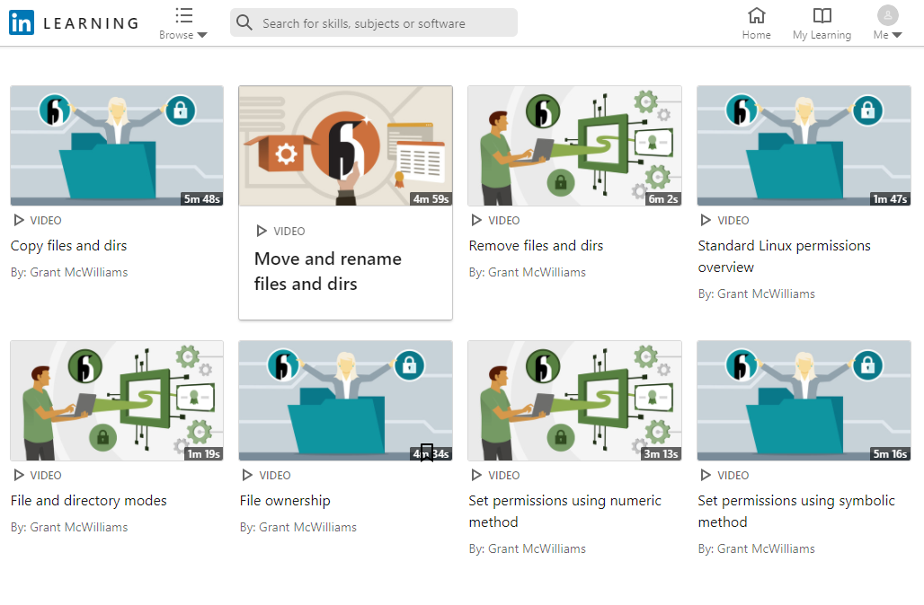
Additional Preparation
Watch the LinkedIn presentations:

Slide 7
Thankyou
End of Session

